Slide 1


Introducing R and the RStudio IDE
Alana Schick, IMC Bioinformatics, University of Calgary
a.schick@ucalgary.ca, @alana_schick

Slide 2

What is R?
R (since 1995) is a programming language developed to teach statistics
R is open source (ie. free), widely used, flexible, and powerful

Slide 3
Packages: the power of R
A way for the R community to share functions and data sets
Importing & Exporting data
From
text files, excel, stata, SPSS , and databases
Data Modeling
Statistical tests
Linear & non-linear models
Machine learning
Survival analysis
Data Sharing
Plotting, interactive plots, reporting with markdown and shinny apps
https://support.rstudio.com/hc/en-us/articles/201057987-Quick-list-of-useful-R-packages

Slide 4

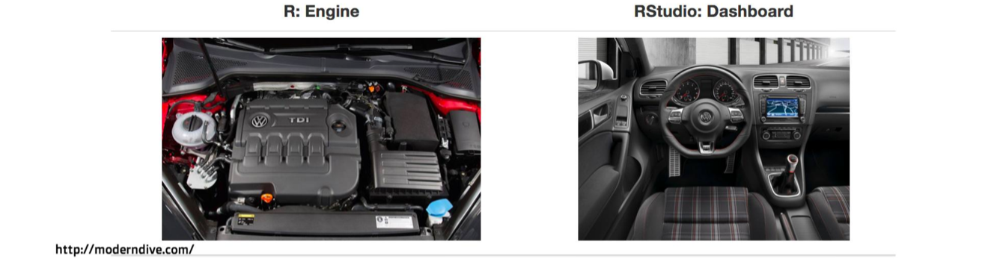
What is RStudio?
RStudio is an Integrated Development Environment (IDE) that allows users to run R in a more user-friendly way
+

Slide 5
Let’s open Rstudio and get to know it !!

Slide 6
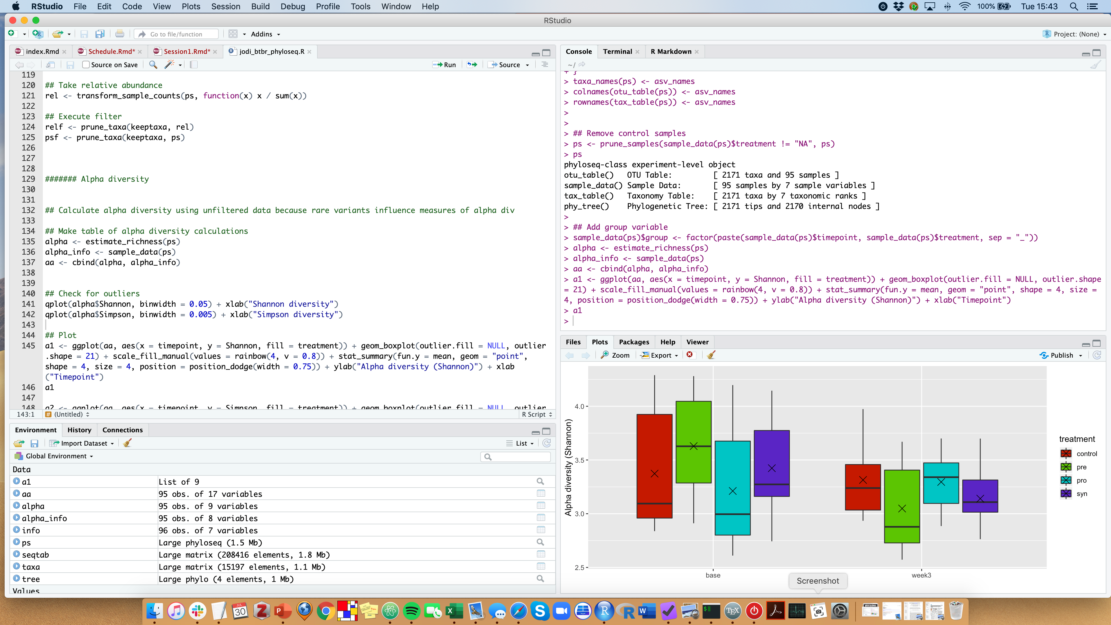
RStudio looks like this

Slide 7
RStudio screen
Console
Script
Plots
Environment

Slide 8
RStudio screen
Console
Script
Plots
Environment

Slide 9
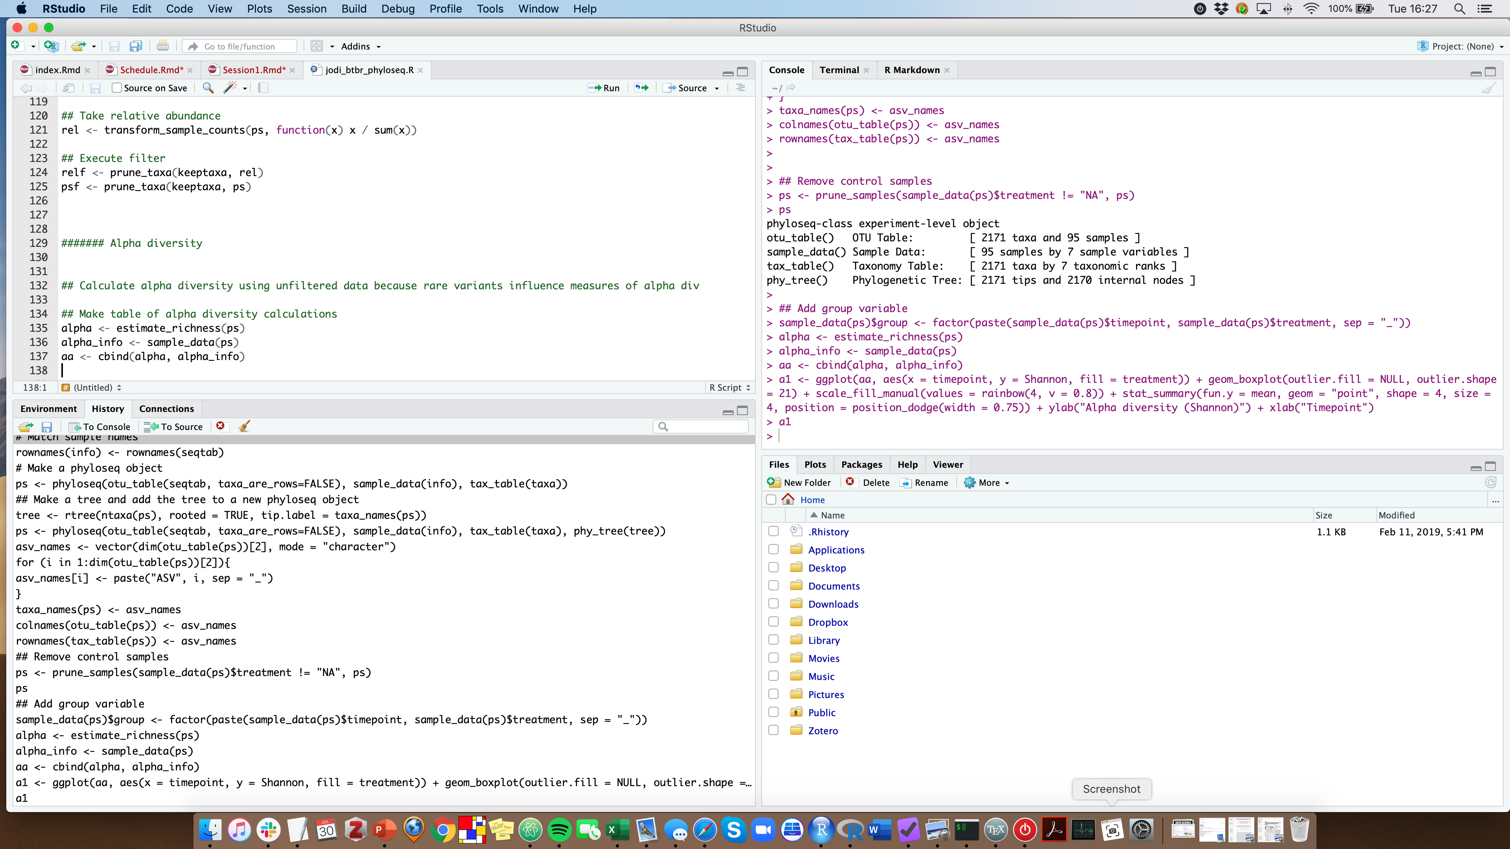
RStudio screen
Console
Script
History
Files

Slide 10
How to R – 2 ways
Console
Script
1. Typing and executing commands interactively here.
2. Using and saving scripts (ie. plain text files of code).

Slide 11

How to R – 2 ways
Console
Script
1. Typing and executing commands interactively here.
2. Using and saving scripts (ie. plain text files of code).
Choose this one.

Slide 12
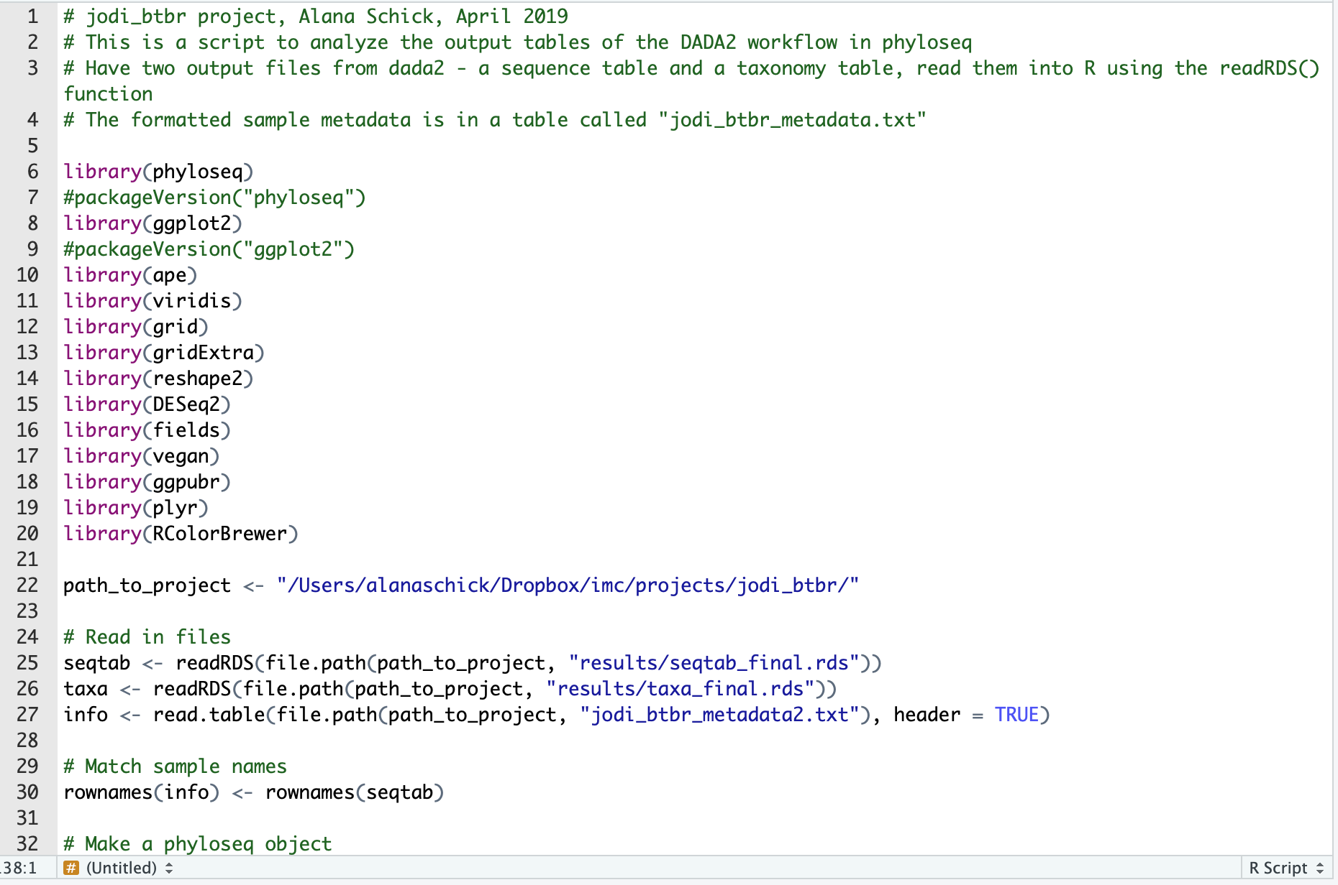
Scripts
Everything in the console will be forgotten when you close the session.
Scripts are saved, keeping a complete record of the commands you ran so you can run them again (ie. completely reproducible).
Can execute parts of this or the entire script.

Slide 13


Scripts - commenting
Comment out lines of your scripts by using the # symbol. R will not run these.
Be descriptive. You will not remember what you did a year later.

Slide 14

Packages
Packages are collections of R functions developed for a specific task.
Packages need to first be installed on your computer.
After installed, library() is the command used to load a package.

Slide 15
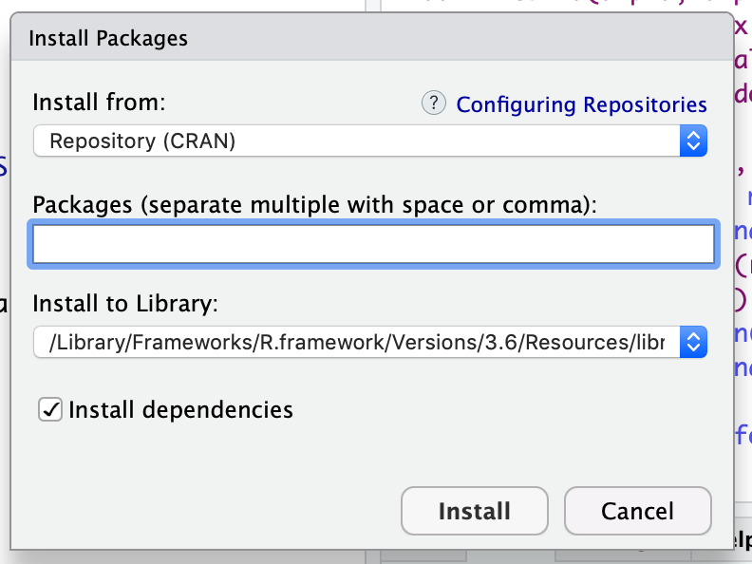
Packages
Tools > Install packages...

Slide 16
Pay close attention to the next few slides
About half of the students in every workshop have problems in understanding the concept of working directory!!

Slide 17
Working directory
Every time you open RStudio, it goes to a default directory, usually your home directory.
You can use the command setwd() to change the working directory.
setwd("home/aschick/projects/workshop")

Slide 18
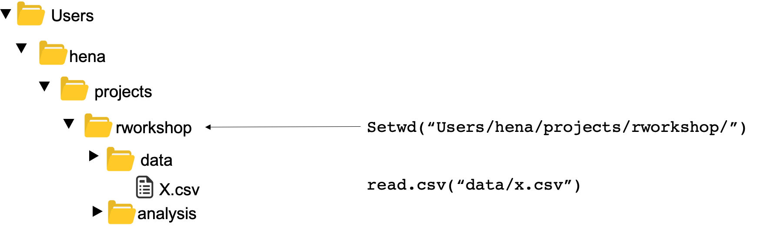
Relative paths

Slide 19
The directory that you see here is not necessarily the same as your working directory. Please do not use this to find your files.

Slide 20
Working directory
However: you may want to run your script on a different computer with a different directory structure where that directory does not exist.
Or you may want to work in multiple directories.

Slide 21
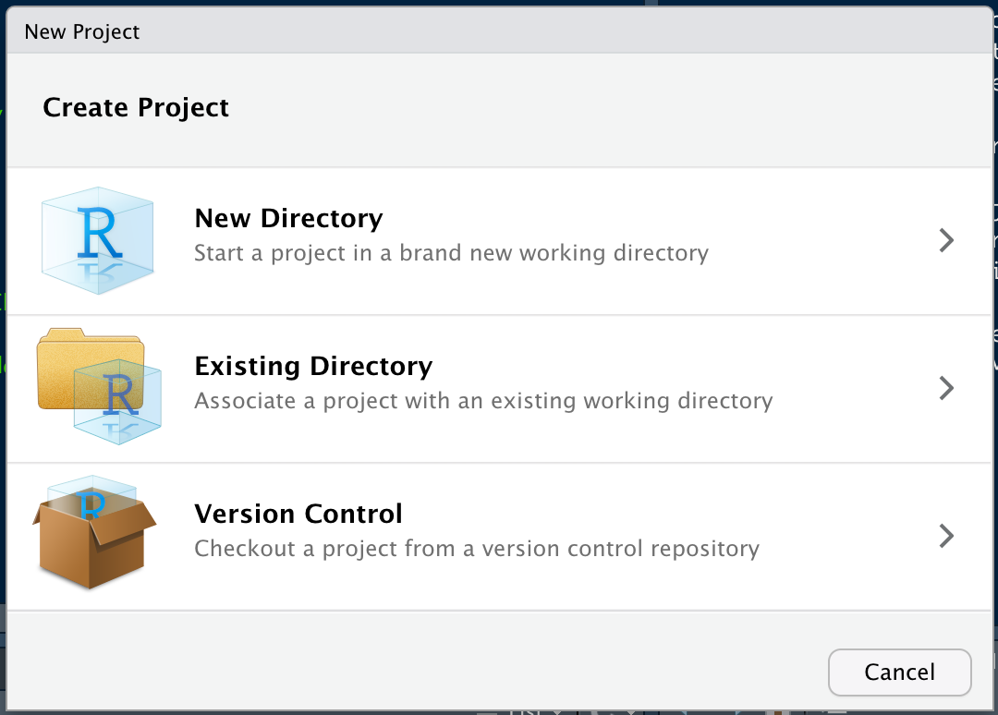
RStudio Project
File > New Project...
Clicking on New Directory will create an RStudio Project.
This directory will have all the data, files, plots, etc. for that project as well as a .Rprog file.

Slide 22
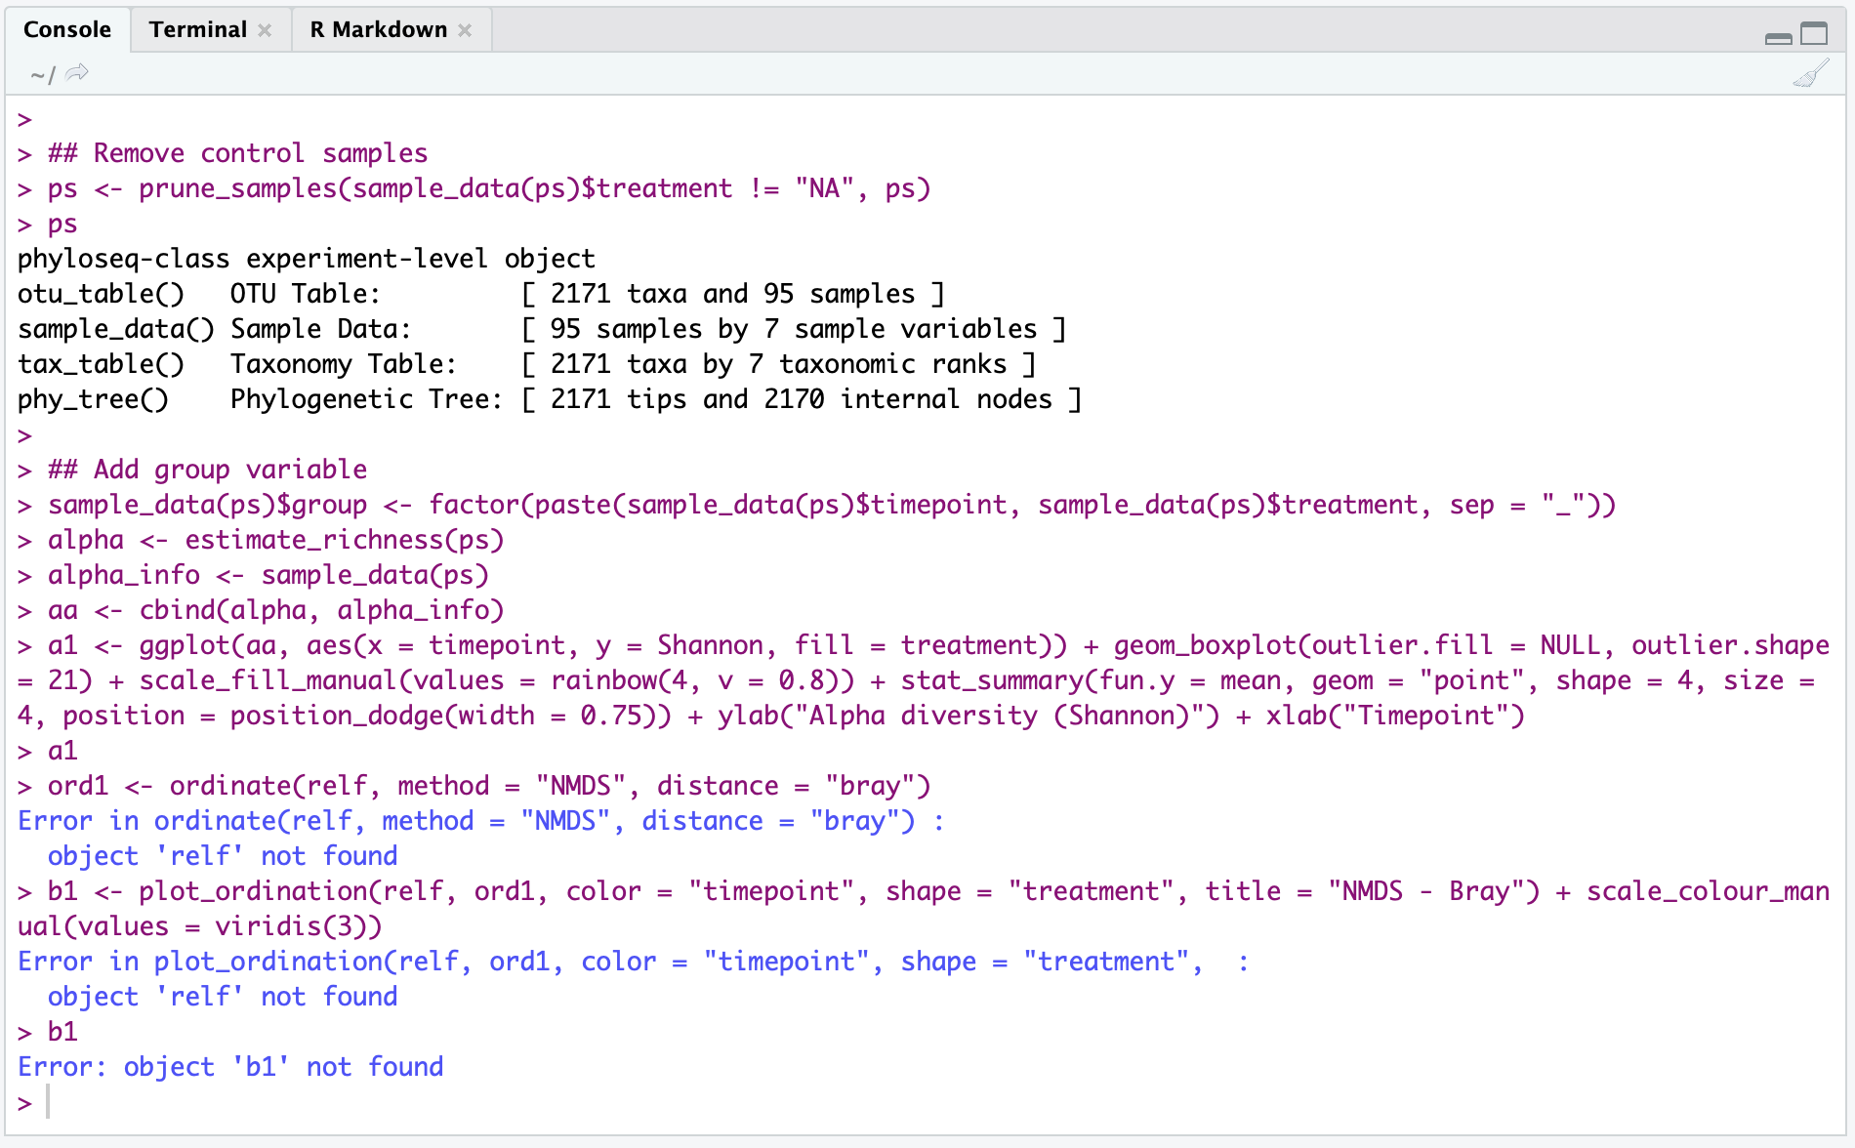
Error messages

Slide 23

Error messages

Slide 24
Getting help
Search in Help tab
Type ? followed by the function name in the console (or ?? for installed packages)
> ?barplot
> ??geom_point

Slide 25
Getting help
Search in Help tab

Slide 26
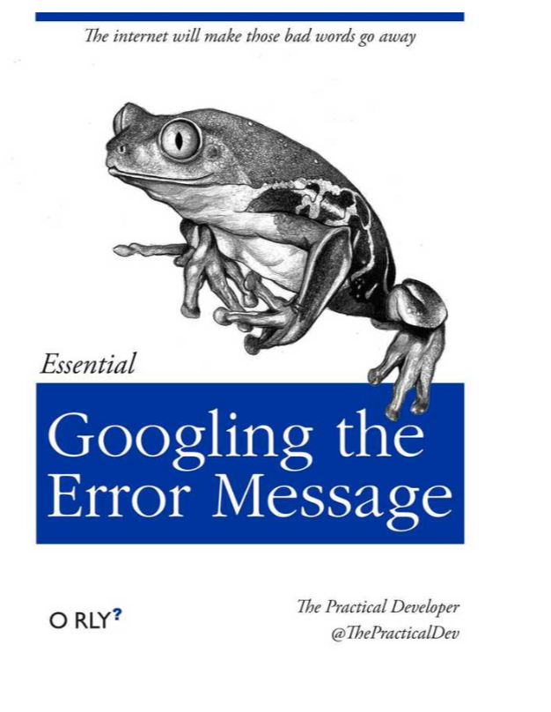
Getting help
Search in Help tab
Type ? followed by the function name in the console (or ?? for installed packages)
Google the error message
See website for tips and resources!

Slide 27
Summary and best practices
Always save your code in R scripts
Load packages using library() at the top of your script
Write clear, readable code with comments*
Be mindful of your working directory or location of files
Use RStudio projects to organize scripts, data, and output
*See http://adv-r.had.co.nz/Style.html for tips.

Slide 28
Data Types
Character
Numeric
Logical
Data Types
Integer
Raw
Complex

Slide 29
Data Structures
Vector
Dataframe & tibble
1d, homogeneous
2d,heterogeneous
columns
Matrix
rows
2d, homogeneous
Lists
heterogeneous
Array
3d, homogeneous
Homogenous means that it can hold only one data type at a time.
Heterogeneous means it can hold multiple datatypes at a time.

Slide 30
Data Structures
Vector
1d, homogeneous
45
1
56
2
62
3
92
4
23
5
39
6
67
7
84
8
Dataframe & tibble
2d,heterogeneous
columns
a
cat
23
b
dog
34
rows
c
bat
5
d
bee
0.4

Slide 31
Data Structures
Vector
1d, homogeneous
45
1
56
2
62
3
92
4
23
5
39
6
67
7
84
8
Index
Dataframe & tibble
2d,heterogeneous
columns
Index =
row,col
1,1 1,2 1,3
1,1
2,1
3,1
a
cat
23
b
dog
34
rows
c
bat
5
d
bee
0.4

